Slide 1

Introduction to Computer Systems
Introduction to Linux
Direct Link to view these slides on Google Docs

Slide 2
What to expect in this topic:
What is Linux?
What is required for a server operating system?
Linux usage:
ls, cd, date, mkdir, wc
Wildcards * and ?
Running previous commands

Slide 3
A Computer
Operating System
CPU
RAM
Monitor
OS
Flash Memory
Keyboard
Printer
Disk CD/DVD
Mouse

Slide 4

Linux
Penguin Tux, the Linux Mascot
Attribution: lewing@isc.tamu.edu Larry Ewing and The GIMP

Slide 5
What is Linux?
Linux is a free open-source operating system based on Unix. Linus Torvalds originally created Linux with the assistance of developers from around the world.
Free
Unix Like
Open Source
Network operating system

Slide 6
What is Linux?
Pure Linux is a kernel.
A kernel provides access to the computer hardware and controls access to resources.
The kernel decides who will use a resource, for how long and when.
You can download the Linux kernel from the official web site at http://kernel.org

Slide 7
What is Linux?
However, the Linux kernel itself is useless unless you get all the applications such as text editors, email clients, browsers, office applications, etc.
Therefore, someone came up with the idea of a Linux distribution.

Slide 8

Linux Distribution Software
There are lots to choose from:

Slide 9
Linux Usage
As a server operating system it provides different services/network resources to a client. A server operating system must be:
Stable
Robust
Secure
High Performance

Slide 10
Linux Usage
Linux runs on a wide variety of computer hardware, including:
Mobile phones
Tablet computers
Network routers
Televisions
Video game consoles
Desktop computers
Mainframes
Supercomputers (90% run some variant of Linux)

Slide 11

Linux Shell
user requests
Not part of the OS
shell
applications
kernel
hardware

Slide 12
Linux Shell
BASH (Bourne-Again Shell) We use this
CSH - (C Shell)
KSH (Korn Shell)
Each shell does the same job, but each understands slightly different command syntax and provides different built-in functions.

Slide 13
Linux File System
/
bin
boot data0
Desktop
dev
etc
home
u1
...
cs1
cs2
isi3
is2
msc
staff
...

Slide 14
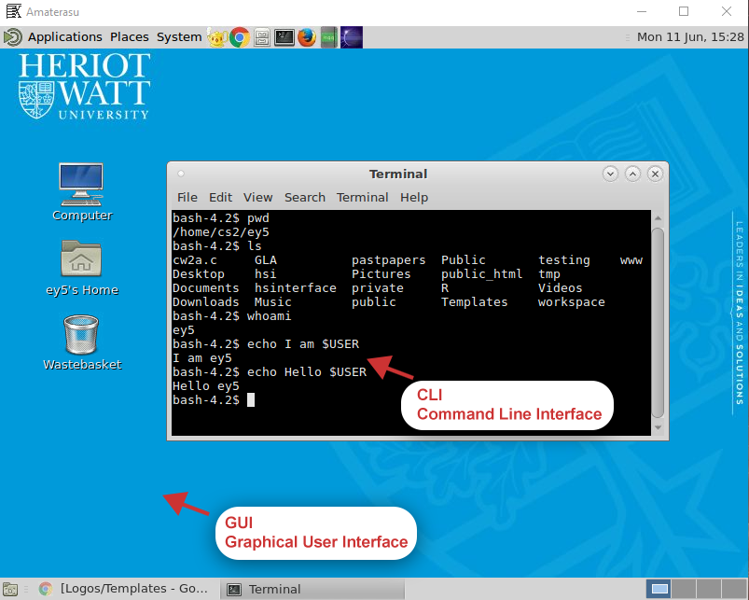
Command Line Interface
The shell provides an interface to Linux where you can type or enter commands using the keyboard. It is known as the command line interface (CLI).

Slide 15
Command Line Interface
Using the shell you simply type commands. A command is a computer program to perform a specific task. Examples of commands include:
ls
cd
date
mkdir
wc
Run Linux or other Operating Systems in your browser! https://bellard.org/jslinux/

Slide 16
OS Concepts
Run different commands without having to type the full pathname to them even when they do not exist in the current directory
Use wildcard characters, such as * or ?, thus saving you laborious typing

Slide 17
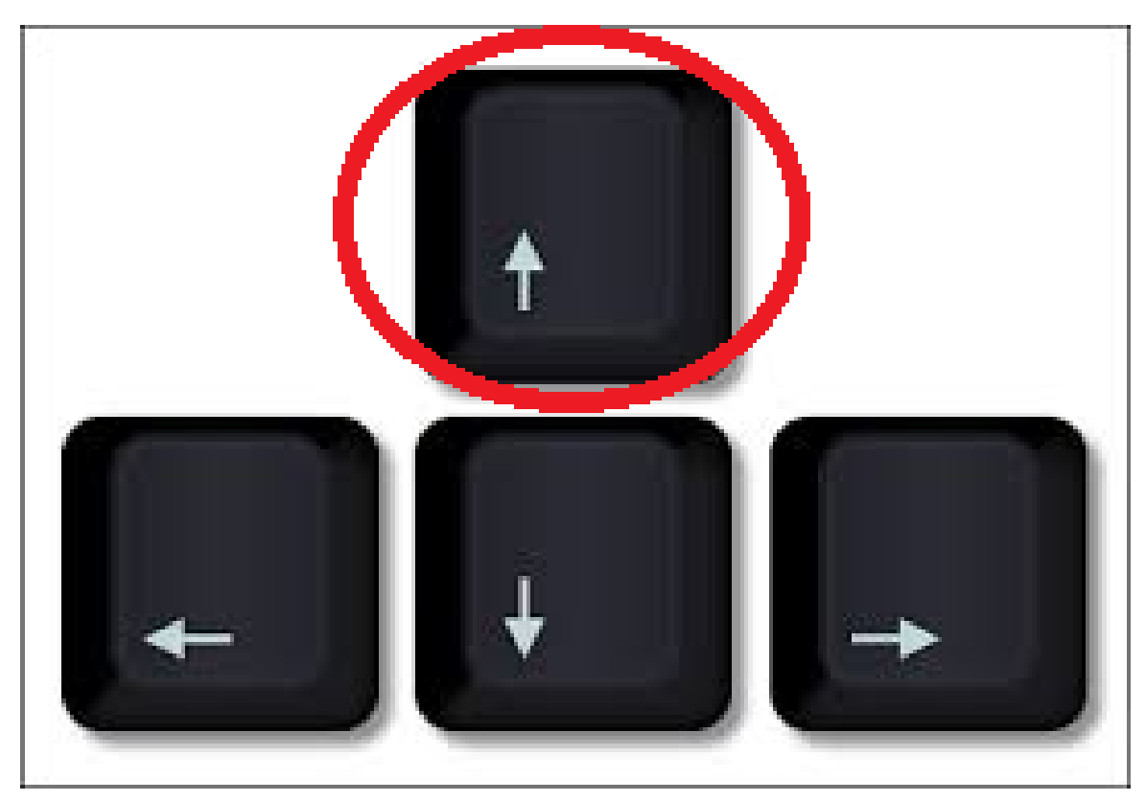
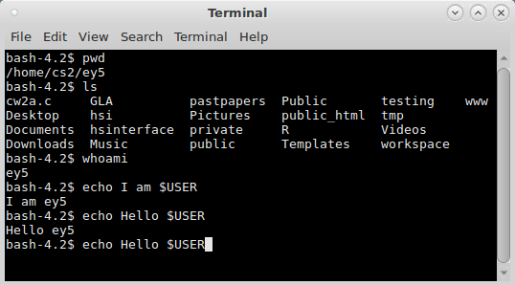
The Shell allows you to:-
Run previously run commands without having to type the full command again by pressing the up arrow, or pulling up a complete list with the history command
Edit / run the command again

Slide 18
Linux Commands
LINUX IS CASE-SENSITIVE. For example: Netscape, NETSCAPE and nEtscape are three different commands.
my_filE, my_file, and my_FILE are three different files.

Slide 19

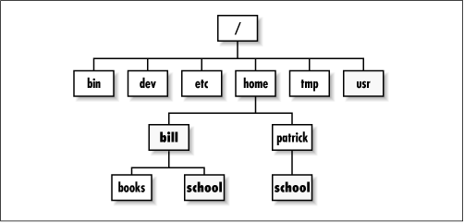
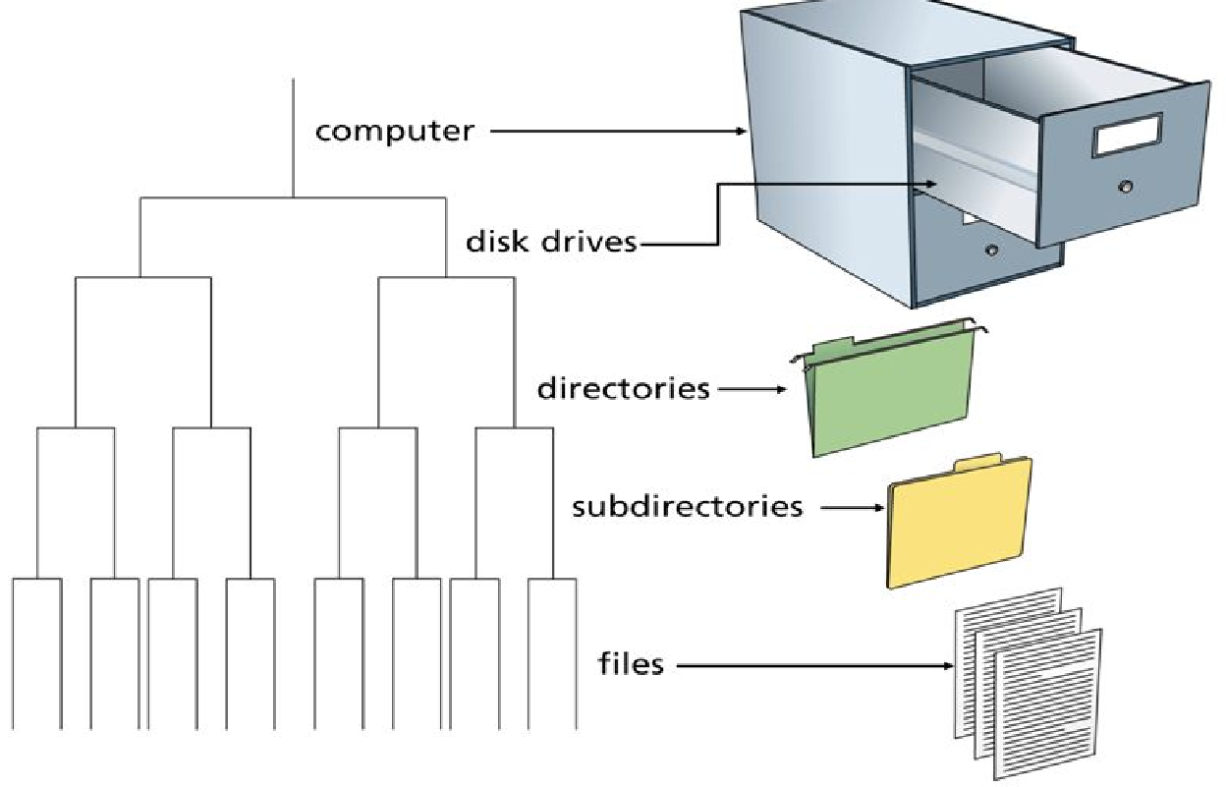
Linux Directories
A Linux directory is a special file that acts as a container for other files and even other directories.
Create directories to hold groups of related files as an alternative to keeping all your files in one huge directory.
A Linux file system is like a filing cabinet with a bunch of folders, each of which can contain subfolders and files.

Slide 20
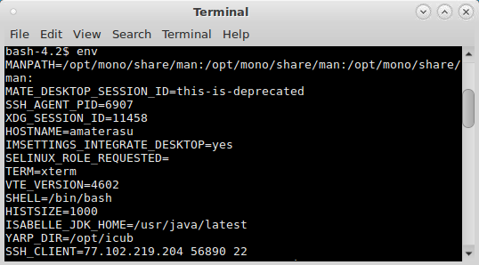
Linux Environmental Variables
Environment variables are a set of dynamic named values that can affect the way running processes will behave on a computer.
$USER is the username used at logon
To list the current values of all environment variables, issue the command env
For more on environment commands, please visit: https://www.computerhope.com/unix/uenv.htm

Slide 21
Commands - echo
The echo command displays a message on the screen and is primarily useful for programmers writing shell scripts but anyone can use echo to show the value of environment variables.
echo $PATH /usr/bin:/usr/local/bin
echo My name is $USER. My name is steve

Slide 22
Directory Commands: mkdir
Use mkdir to make/create a brand new directory
Type mkdir followed by the name of a directory.
mkdir testdir

Slide 23
Directory Commands: cd
Use cd to change directories
cd games
If games is not in the current directory, then the complete path must be written out.
cd/usr/games
To access the parent of the current directory use
cd..
pwd prints out the current directory

Slide 24
Directory Commands: ls
Type ls to see a list of the files and directories located in the current directory. If you’re in the directory named games and you type ls, a list will appear that contains files in the games directory and sub-directories in the games directory. To list files and directories for another directory, type:
ls Mail
ls /usr/bin

Slide 25
Directory Commands: cp
To copy a file type cp followed by the name of an existing file and the name of the new file.
cp oldfile newfile
If the new file doesn’t exist it will be created, if it does, the contents will be overwritten
cp chess ../games-scores/chess-score
cp checkers /u1/cs1/fred/games-scores
If the new file is an existing directory, the file will be copied there

Slide 26
Directory Commands: mv
To move or rename a file type mv followed by the current name of a file and the new name of the file.
mv oldfile newfile
If new file is an existing directory, old file will move there with the same name

Slide 27
Directory Commands: rm
Delete one or more files. To remove a file, you must have write permission in the directory that contains the file. If you do not have write permission on the file, you will be prompted to override.
rm newfile
Use wildcard characters to remove several files
rm n* (USE WITH CAUTION)

Slide 28
I/O Redirection
The default output is to the screen however this can be redirected, normally to a file.
ls -lR > dir-tree.list
Creates a file containing a listing of the directory tree.

Slide 29
I/O Redirection
However when redirecting the output you may not wish to override an existing file but append the output to the end of the file. This can be done as follows
ls -lR >> dirinfo.list

Slide 30
I/O Redirection
To redirect standard input from a file instead of the keyboard, the "<" character is used
sort < file_list.txt
The sort command processes the contents of file_list.txt. The results are output on the display since the standard output is not redirected in this example.

Slide 31
I/O Redirection
We could redirect standard output to another file like this
sort < file_list.txt > sorted_file_list.txt

Slide 32
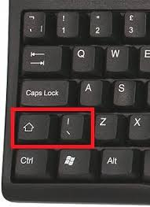
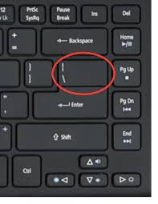
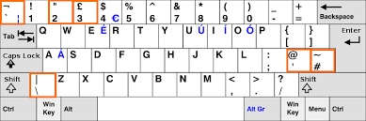
I/O Redirection | Pipes
Standard output from one command can be piped into the standard input of another
ps agx | grep firefox
Output of the ps (process status) command becomes input to the grep command
Grep is a command line utility for searching through data sets for regular expressions and to print them. It stands for Globally search a Regular Expression and Print
In this example, grep will report any process with the name firefox
Pipe symbol on keyboard

Slide 33
Linux - Wildcards * (Asterisk)
*represents any sequence of characters.
Including a * in your filename means that part of the filename can be formed using any sequence of characters.
ls *gif*
Would list all the files containing the letters 'gif' in them. So a file named somegifs.txt as well as a file named 123.gif would be listed

Slide 34
Linux - Wildcards ? (Question Marks)
? represents only one character which can be any character.
ls ??.gif
Would list all the .gif files in the current directory that have only 2 characters before the extension. Thus files such as ab.gif or xy.gif would be listed but 123.gif would not be listed
Remember that only ONE character will be substituted in the place of the ?

Slide 35
Linux - Wildcards [] (Square Brackets)
[]represents a range of characters.
ls article1[0-4]
would list files that are named article10, article11, article12, article13 and article14.
ls beckham[123].jpg
would list all the files that begin with the letter sequence 'beckham' and end with either a 1, 2 or 3, before the suffix ‘.jpg'

Slide 36
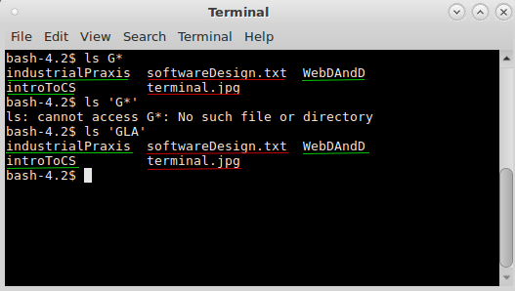
Linux - Wildcards [] (Square Brackets)
Whenever you use single quotes (' ' ) the shell suppresses the filename expansion. Thus even if you use a wildcard such as * but enclose it within single quotes you would not get the standard feature of matching for all characters.
ls 'u*'
would search for a file named ' u* '. There would be no expansion of the * to match other letter sequences.
Key
Directories
Files

Slide 37
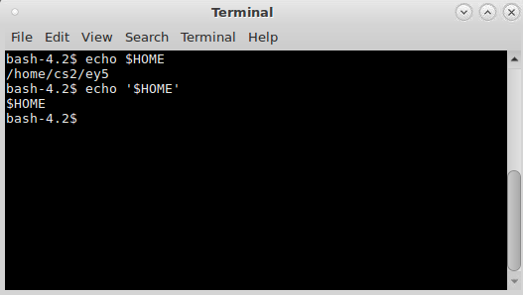
Linux - No Change ‘ (Apostrophe Mark)
Basically the ' (apostrophe marks) disables transformations or modifications.
It considers whatever is enclosed with the ' marks as a single entity
i.e. a single parameter. Absolutely no sort of substitution or expansion would take place.
echo ‘$HOME’
Would output the string $HOME itself
It would not print the path to your home directory.
** To print the path to your home
directory just type echo $HOME
without ' (apostrophe marks)
Prints path to home directory
Prints output the string $HOME itself

Slide 38
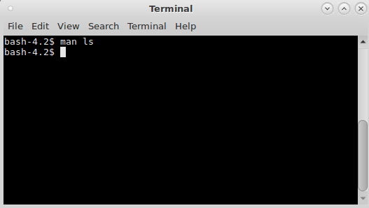
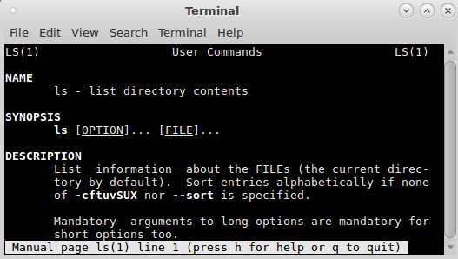
Linux - Commands - man
man is short for manual and is used to pull up information on a Linux command.
Type man followed by a command to get detailed information about hot to use the command.
man ls

Slide 39
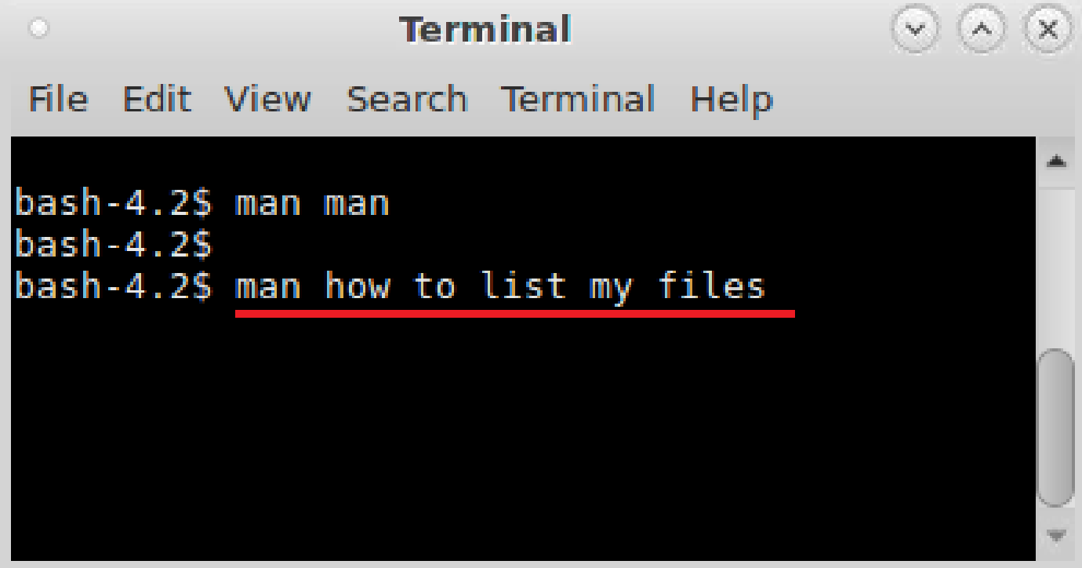
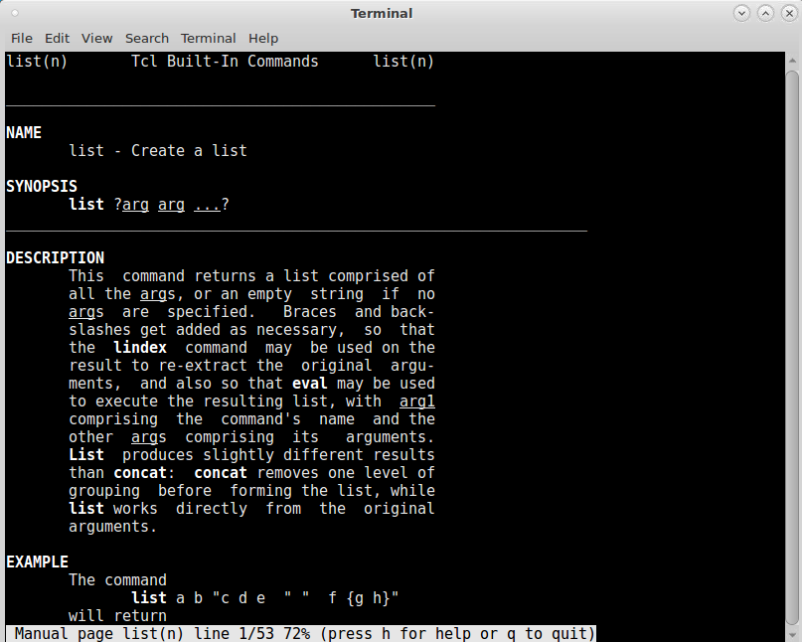
Linux - Commands - man - apropos
What if you need to do a specific task but don't know what program or command to use for the task?
Every man page entry contains a short description of the program, but the problem is that you don't know what program to use and what man page to read!
With the apropos command you can search those descriptions and find the right tool for the job. You can use keywords to search both program names and their descriptions.
apropos directory
you can however use more than just one keyword:

Slide 40
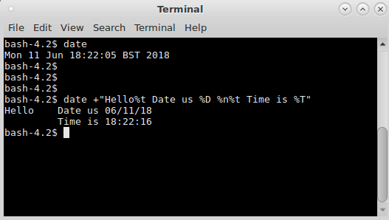
Linux - Commands - date
date - print the system date and time
date Returns:
Mon 11 Jun 18:22:05 BST 2018
** You can add a message with the date:
date +"Hello%t Date is %D %n%t Time is %T"
Returns:
Hello Date is 03/22/18
Time is 18:12:12

Slide 41
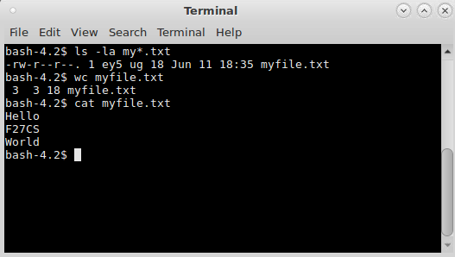
Linux - Commands - wc
Wc - Print byte, word, and line counts for each file.
wc myfile.txt
Displays information about the file myfile.txt.
Below is an example of the output.
3 3 18 myfile.txt
3 = Lines, 3 = Words, 18 = Characters

Slide 42
Commands - wc
Count the words in three essay files:
wc -w essay.[123]
Count lines in the file named by variable $file (don't display filename):
wc -l < $file
Count the bytes in files starting with ab:
wc –c ab*

Slide 43
Commands - wc
Allows you to look, modify or combine a file
cat file1.txt
Displays file1.txt on the screen
cat file1.txt file2.txt > file3.txt
Reads file1.txt and file2.txt and combines those files to make file3.txt.

Slide 44
Commands - grep
The grep command searches text files for a particular word or string of words. Very helpful when trying to find that needle in a haystack, like a particular line in a large log file.
grep century history.text.doc

Slide 45
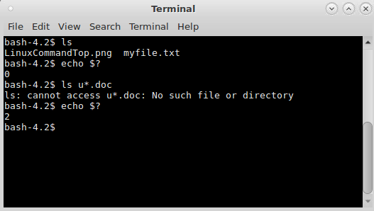
Linux - Exit Status
Every command returns an exit status (sometimes referred to as a return status or exit code).
A successful command returns a 0, while an unsuccessful one returns a non-zero value (e.g. 1,2…etc.) that usually can be interpreted as an error code.
You can find out the exit status of the last command by using $? As in:
echo $?

Slide 46
Linux Summary
Linux is an open-source operating system based on Unix
User Requests/Shell/Kernel/Hardware/Applications
BASH scripting
Linux File System and Command Line Interface
Environment variables
Linux commands: mkdir, ls, cd, pwd, cp, mv, rm, sort, man, date, time, wc, cat, grep and wildcards ? and *

